Slide 1
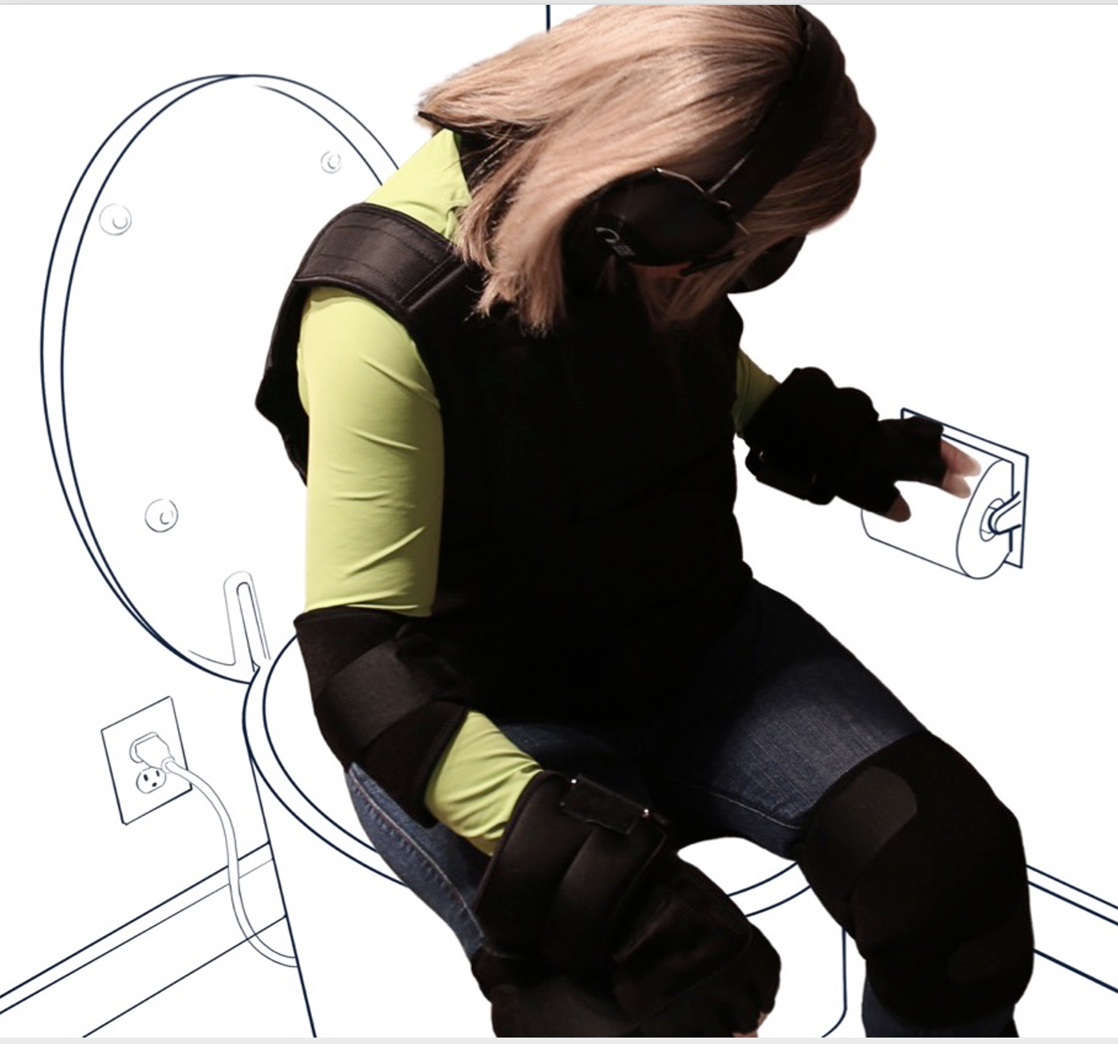
Deana McDonagh Professor of Industrial Design
Director of the (dis)Ability Design Studio
Beckman Institute for Advanced Science and Technology
Affiliate Research Page
Email: mcdonagh@illinois.edu
Created: April 2024
Bringing into the new product development process the voice of individuals that may be typically overlooked and underserved. Empathic design research can ensure an individuals personal lived experience and needs are reflected in design outcomes.
Research Interests
Designed by rather than design for new product development
Integrating the lived experience into the design process
Empathic design to ensure products, services and environments ensure the user maintains their independence, dignity and quality of life
Current Projects
Wheelchair of the future (PURE) that is omnidirectional, handsfree and self-balancing
Aging in Place – house that is future proofed for existing and future needs
Reimagining surgical tools for female surgeons
Keywords
Empathy, empathic modeling, aging in place, new product development, innovation, industrial design, design research, destigmatizing disability
Interest Areas for Collaboration/Future Work
Dr. McDonagh is interested in collaborating with experts that can transform the bathroom and kitchen into responsive entities that capture important biodata to support more customized nutrition, can alert the individual (or carers) to potential health issues (preventatively) and scan the body to help identify any changes in skin (areas that cannot be easily monitored).
University of Illinois Urbana-Champaign Carl R. Woese Institute of Genomic Biology 1206 West Gregory Drive | Office 3113, MC 195 Urbana, IL 61801 personalizednutrition@illinois.edu
Personalized Nutrition Initiative

